Slide 1



Modeling in Databases with R
Best practices for working with Big Data in R
James Blair, Solutions Engineer @ RStudio
October 2019
Notes:
Add graphic of server on the right hand side here

Slide 2
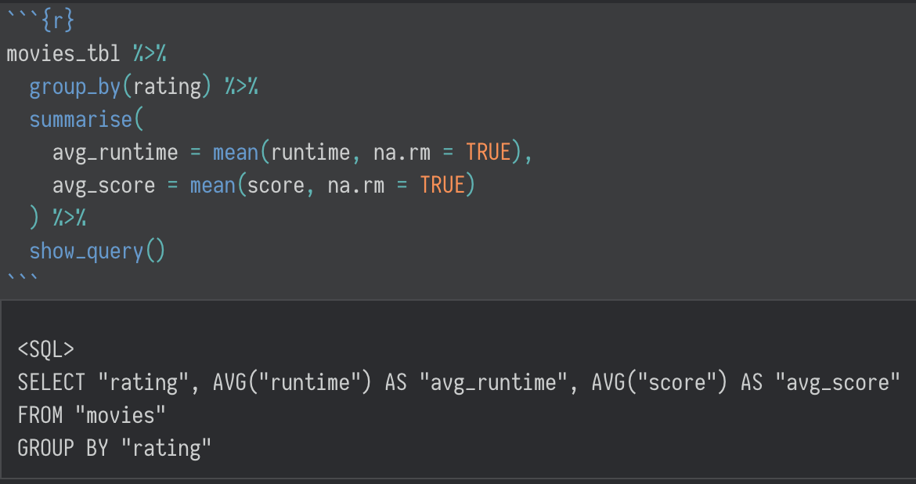
Agenda
Big Data, Big Problems
Databases with R
R Packages
dbplot
corrr
tidypredict
modeldb
Demo
Resources
Notes:
Add graphic to right hand side – maybe some code and associated output

Slide 3
Big Data, Big Problems
Data > RAM
Garrett Grolemund

Slide 4
Big Data, Big Problems
Sample
Parts
Whole
Most common approach for modeling
Most common approach for general analysis
In most cases, the preferred approach, it’s just not feasible

Slide 5
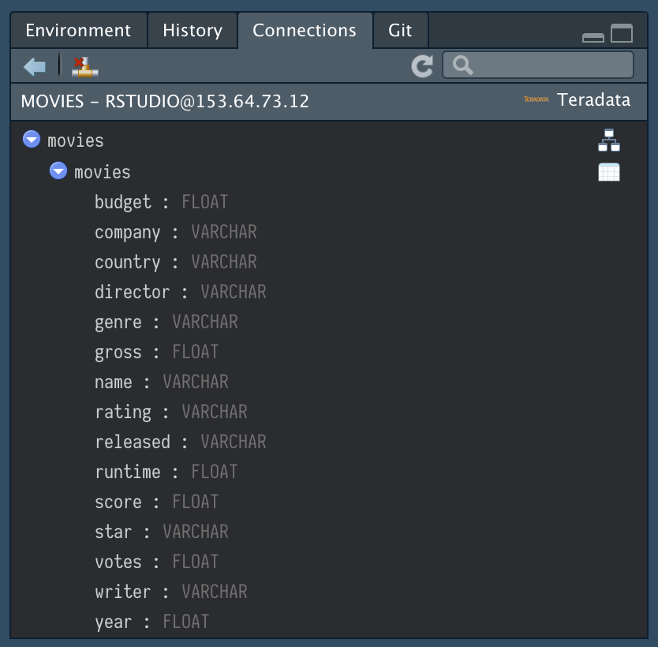
Databases with
Connect using ODBC
Query with SQL
Use common tidyverse verbs
Preview data inside RStudio

Slide 6
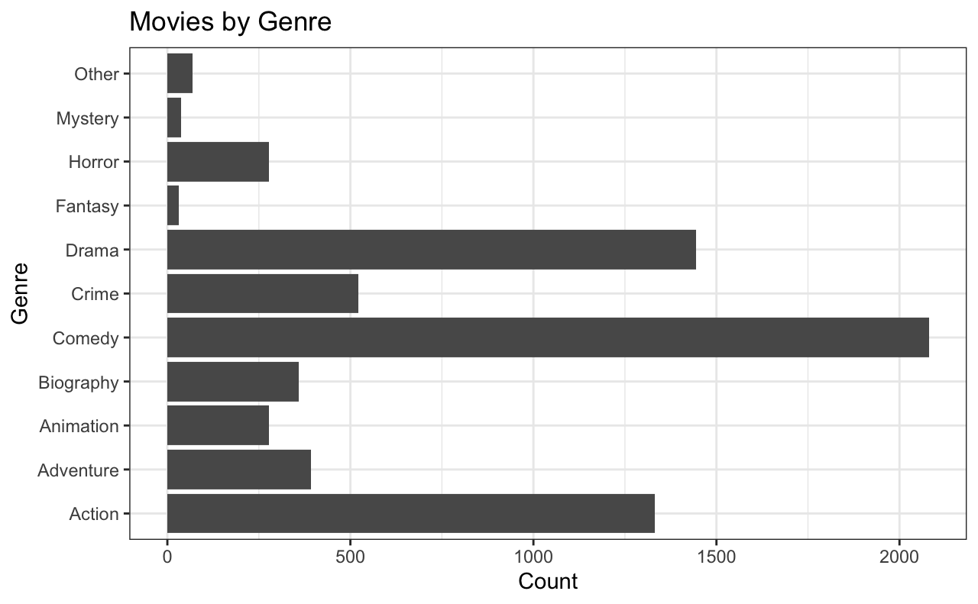


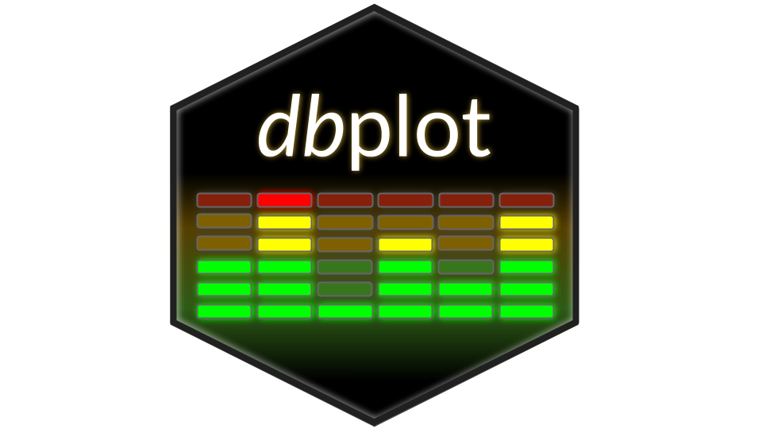

R packages

Slide 7
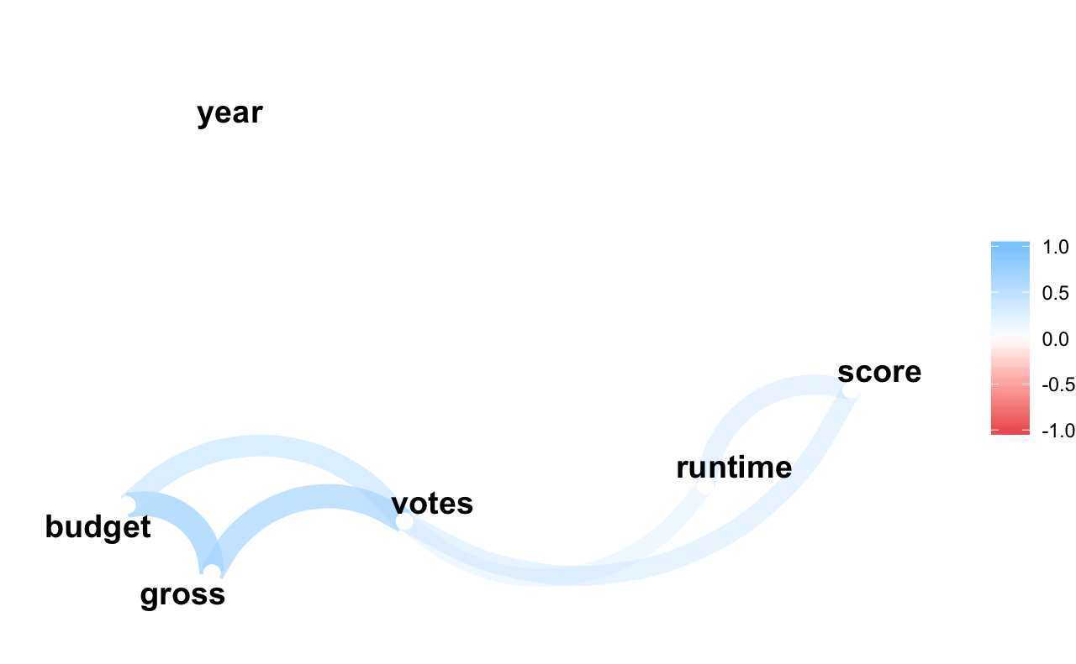
R packages

Slide 8
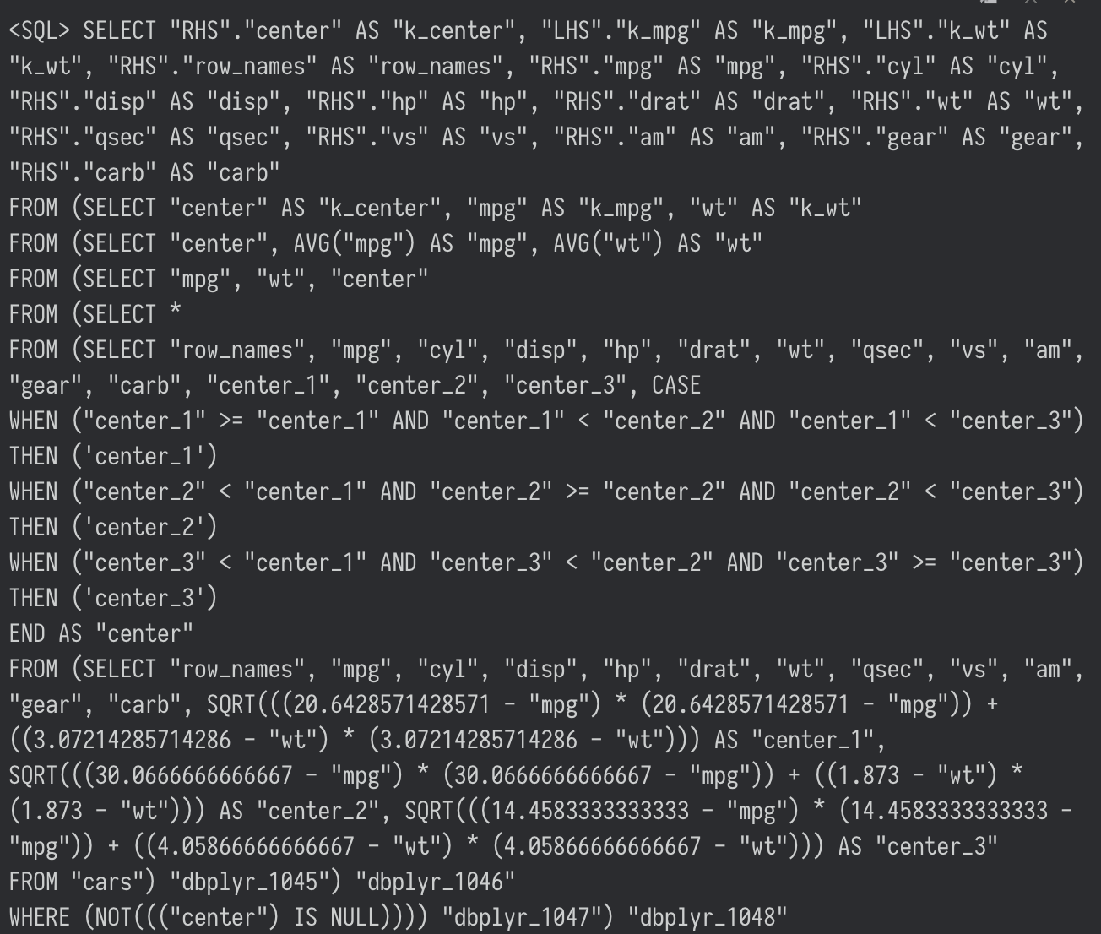
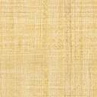
R packages

Slide 9
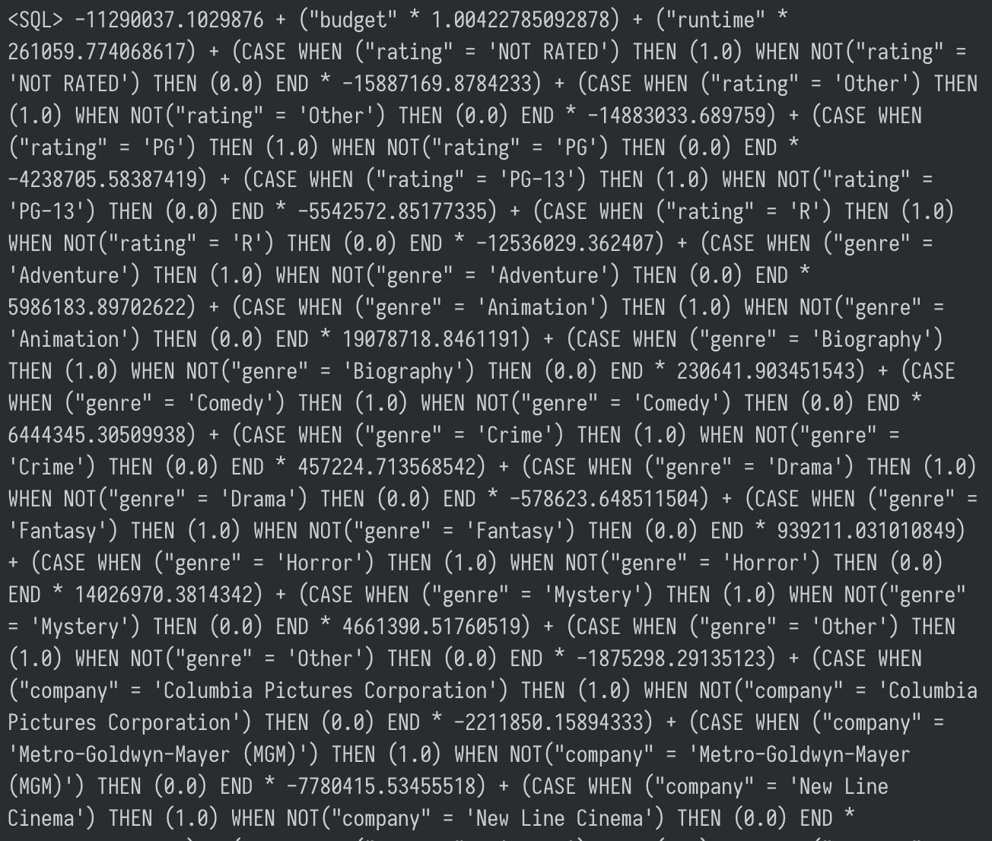
R packages

Slide 10
R packages

Slide 11

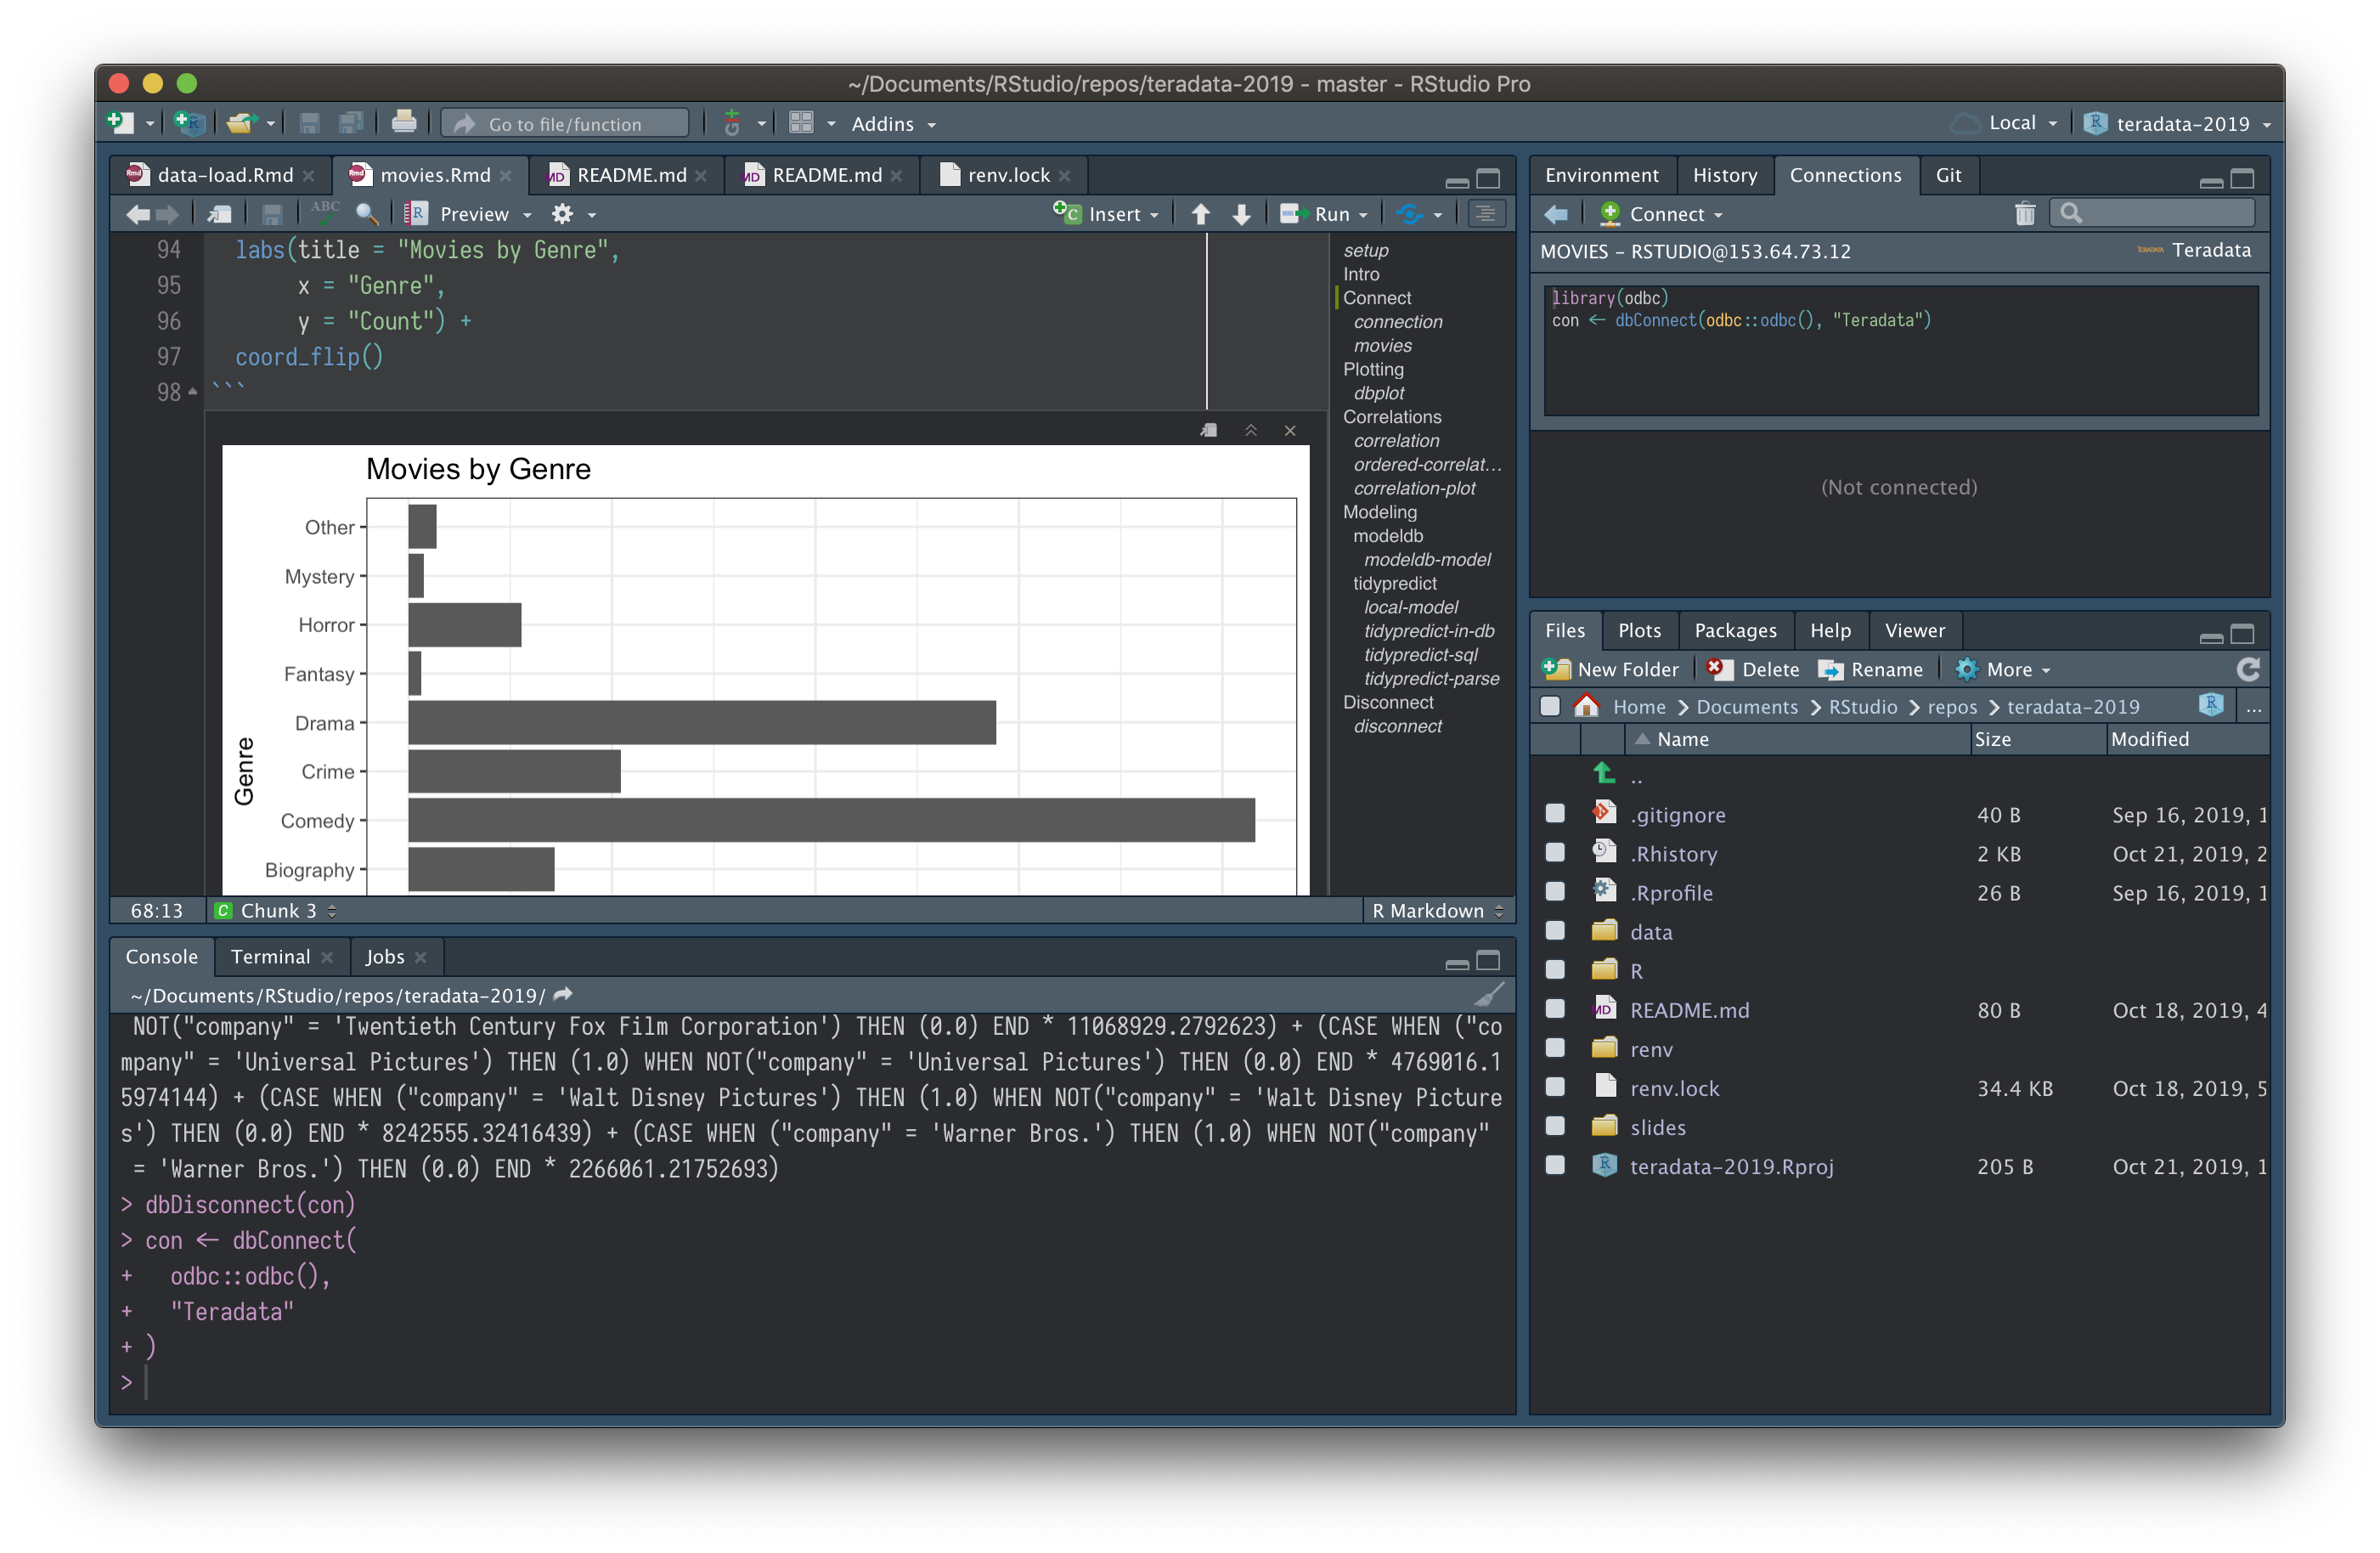
Demo

Slide 12

Resources
db.rstudio.com
github.com/tidymodels
github.com/blairj09/teradata-2019
tdplyr

